Slide 1

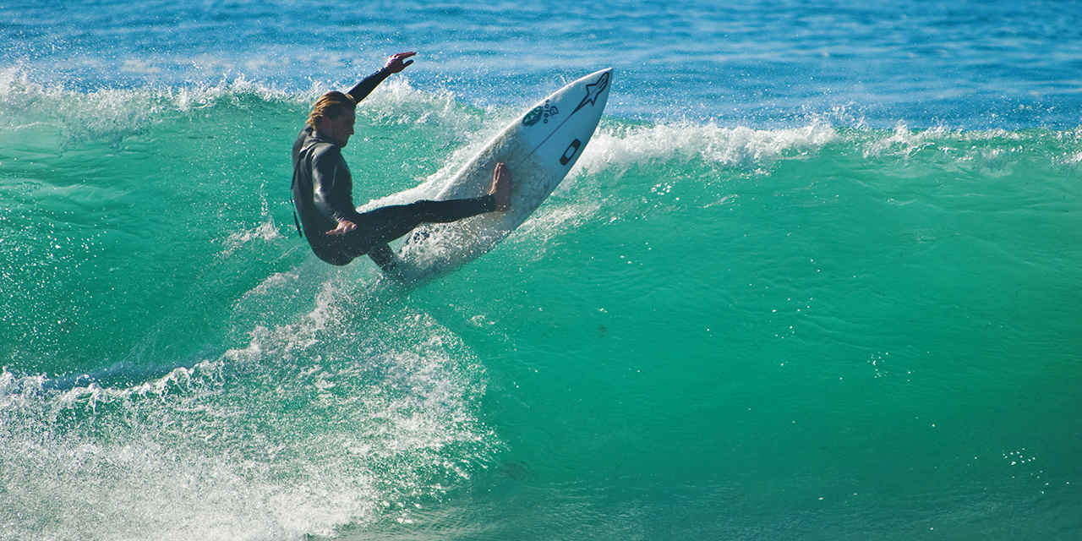
Welcome to Earth Science Online!
Dates: March 30 – April 3
Learning Goal of the Week:
Students will be able to describe how waves carry energy
Assignment Schedule for This Week:
M: Read the article, “Surfer’s Up” and
highlight key points
T: Reread article and answer questions
W: Finish article and questions
TH: Enrichment Opportunity: Watch the Brain POP: Waves and take the online quiz to test your knowledge, see Related Reading-Sports tab
F: Submit work by noon!
Interesting Science Videoclip:
Coronavirus explained https://www.youtube.com/watch?v=BtN-goy9VOY&feature=share&app=desktop
Need help?
Email or send me a message through teams. Visit me on our class TEAMS page during my office hours: Monday-Friday
11:00 a.m. – 1:00 p.m.
Karin Johnson
johnsonk3@leonschools.net
Add fun clip art, pic of you/fam … personalize

Slide 2
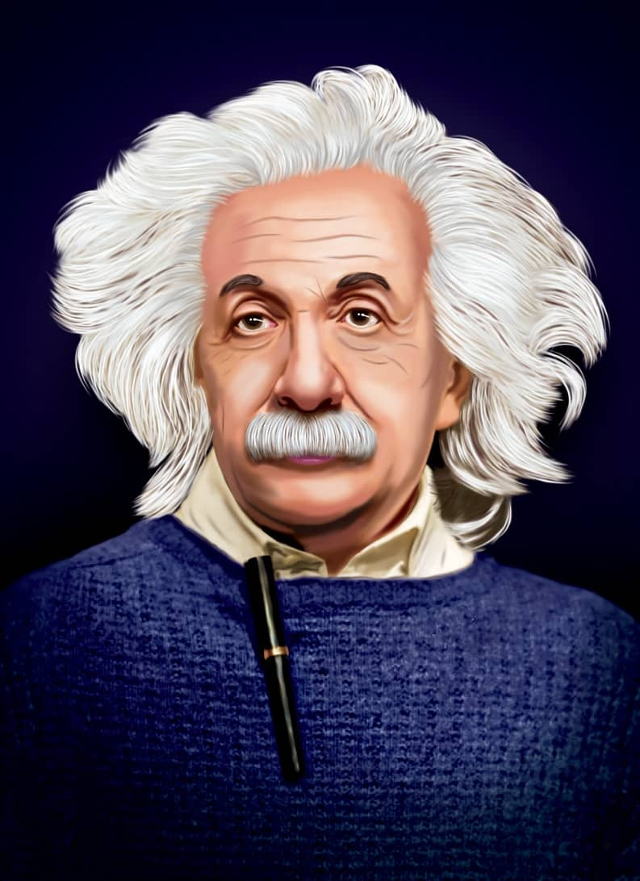
Welcome to Earth Science Online!
Dates: April 6– April 10
Learning Goal of the Week:
Students will be able to describe how waves carry energy
Assignment Schedule for This Week:
M: Read the article, “Was Einstein A Space Alien” and highlight key points
T: Reread article and answer questions 1-6
W: Answer the discussion questions-you may collaborate with another student or your parent to discuss questions before answering
TH: Enrichment Opportunity: Watch the Brain POP: Albert Einstein and take the online quiz to test your knowledge, see Related Reading tabs also to learn more about Einstein!
F: Submit work by noon!
Interesting Science Videoclip:
Einstein’s Miracle Year
https://www.ted.com/talks/larry_lagerstrom_einstein_s_miracle_year?language=en#t-5353
Need help?
Email or send me a message through teams. Visit me on our class TEAMS page during my office hours: Monday-Friday
11:00 a.m. – 1:00 p.m.
Karin Johnson
Johnsonk3@leonschools.net
Add fun clip art, pic of you/fam … personalize

